Slide 1
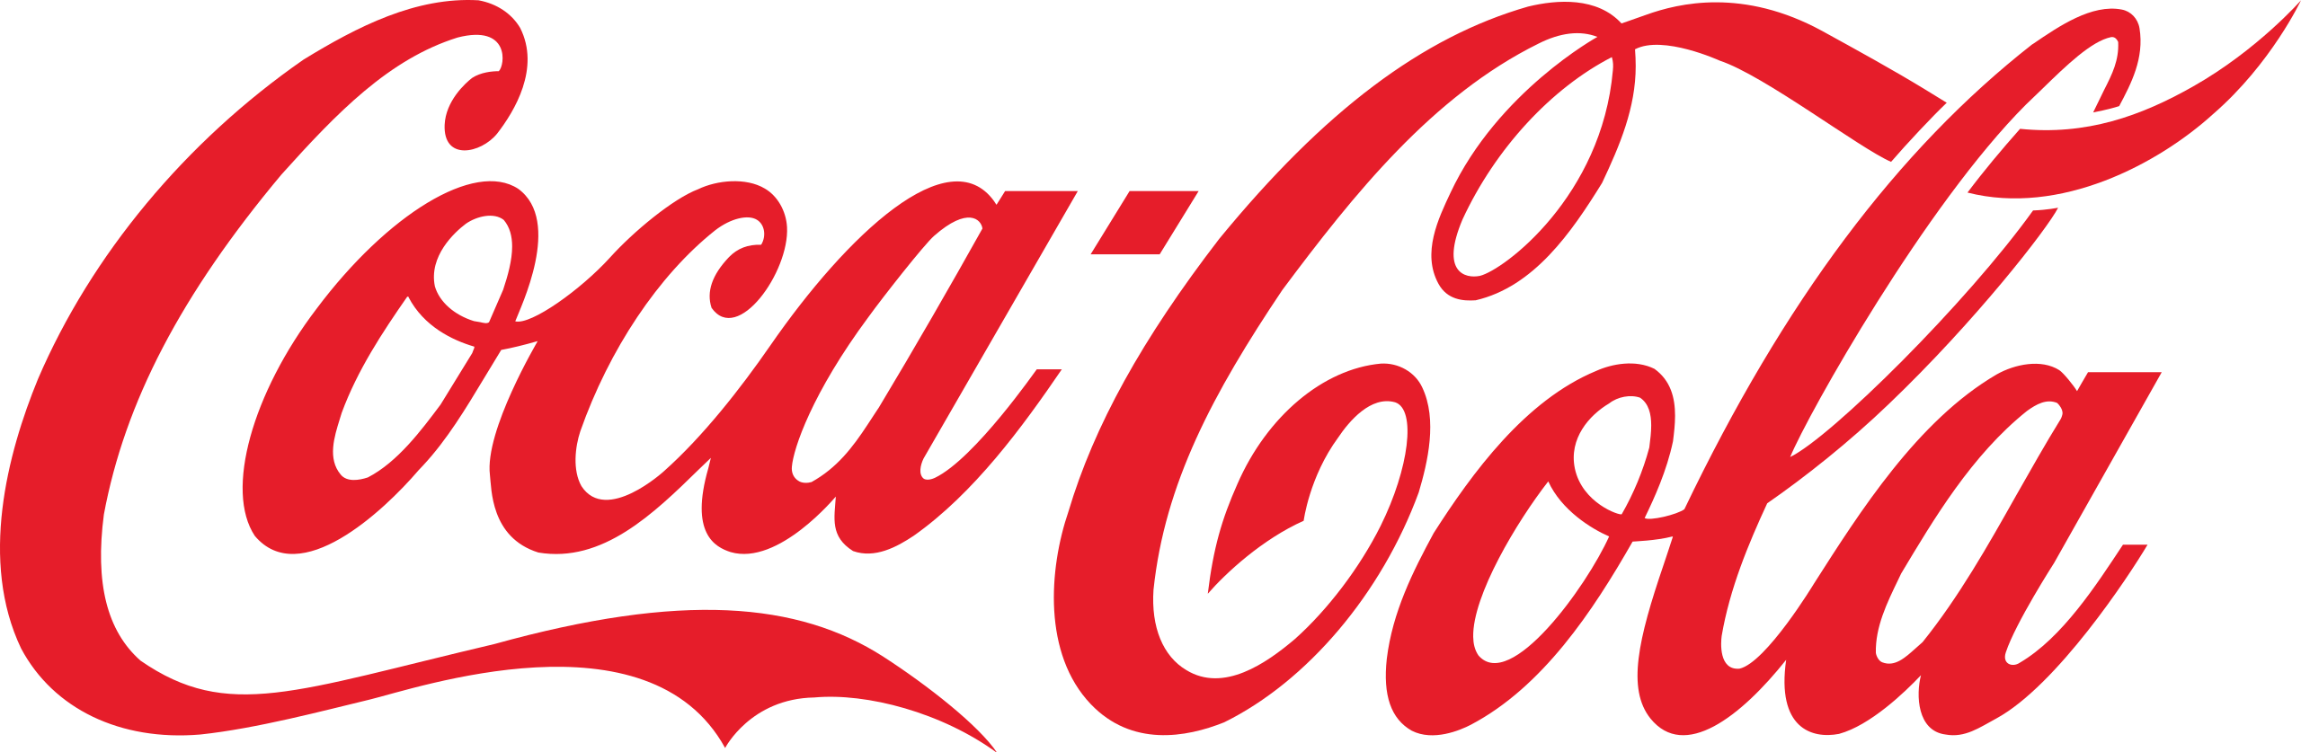
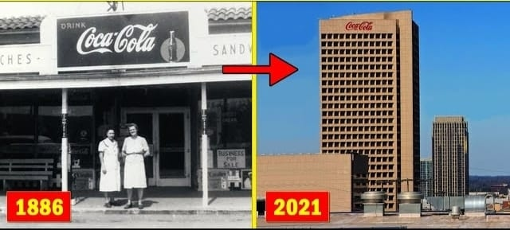
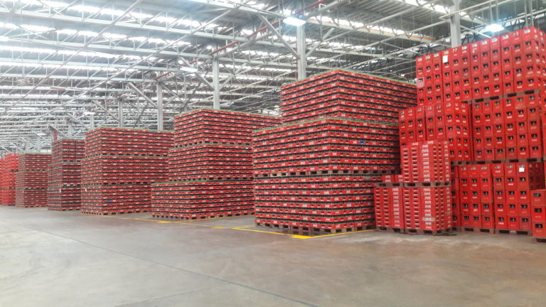
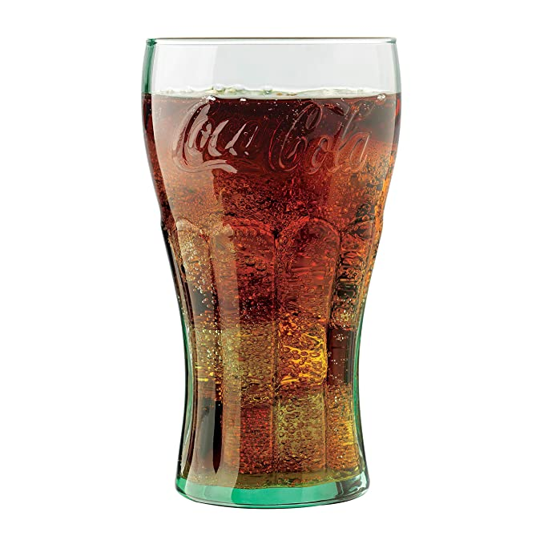

Slide 2
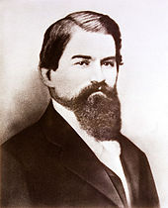
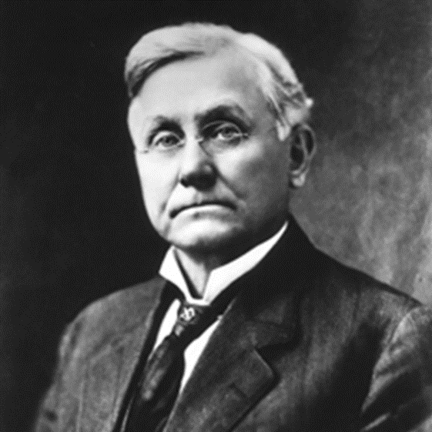
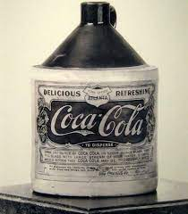
History of Coca-Cola
The Origin of Coca-Cola.
Why Coca-Cola was named Coca-Cola.
Dr. John Pemberton sold the company.
Asa Grigs Candler acquired the Coca-Cola company.
Coca-Cola sustainability history.
Dr. John Pemberton
Asa Grigs Candler

Slide 3
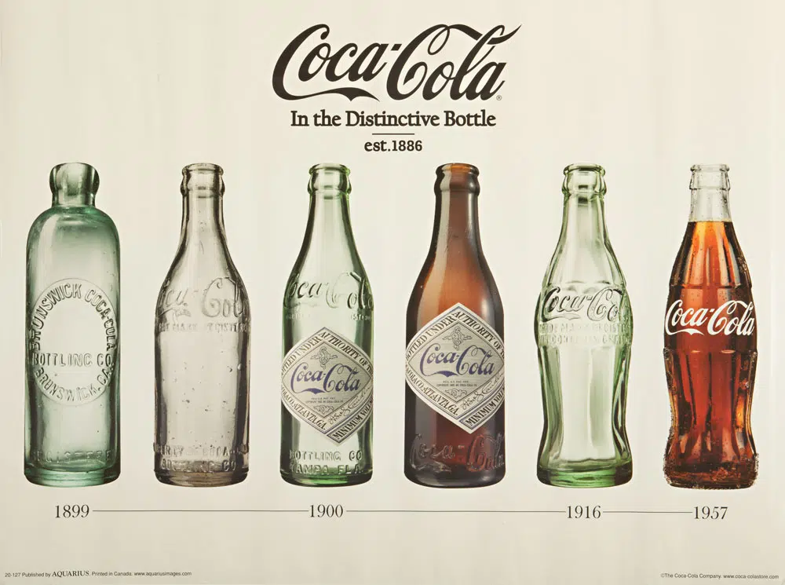
Packaging Innovation
Contour shaped Coke bottle was the company’s first innovative idea to differentiate itself from its competitors
1916-1955
1955 - King And family sized packaging were introduced
Options to buy 10,12,16,26 ounces bottles
Ultra Glass contour bottle is designed to improve impact resistance, and reduce weight and cost
Ultra Glass bottles are 40% stronger, 20% lighter and 10% less expensive
1960 - 12 ounce steel cans introduced
2009 -100% recyclable bottles introduced

Slide 4
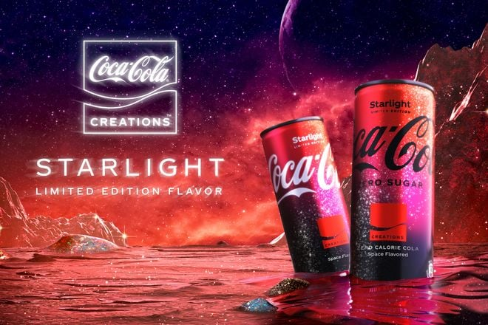
Research & Development
NetEase – Cloud based social media analytics tool
Coca-Cola Freestyle – Fountain Drink Dispenser
TensorFlow’s Machine Learning Framework
AI powered Vending Machines
Coca-Cola Creations - Starlight
Coca-Cola Signature Mixtures
Coca-Cola Zero Sugar Zero Caffeine

Slide 5
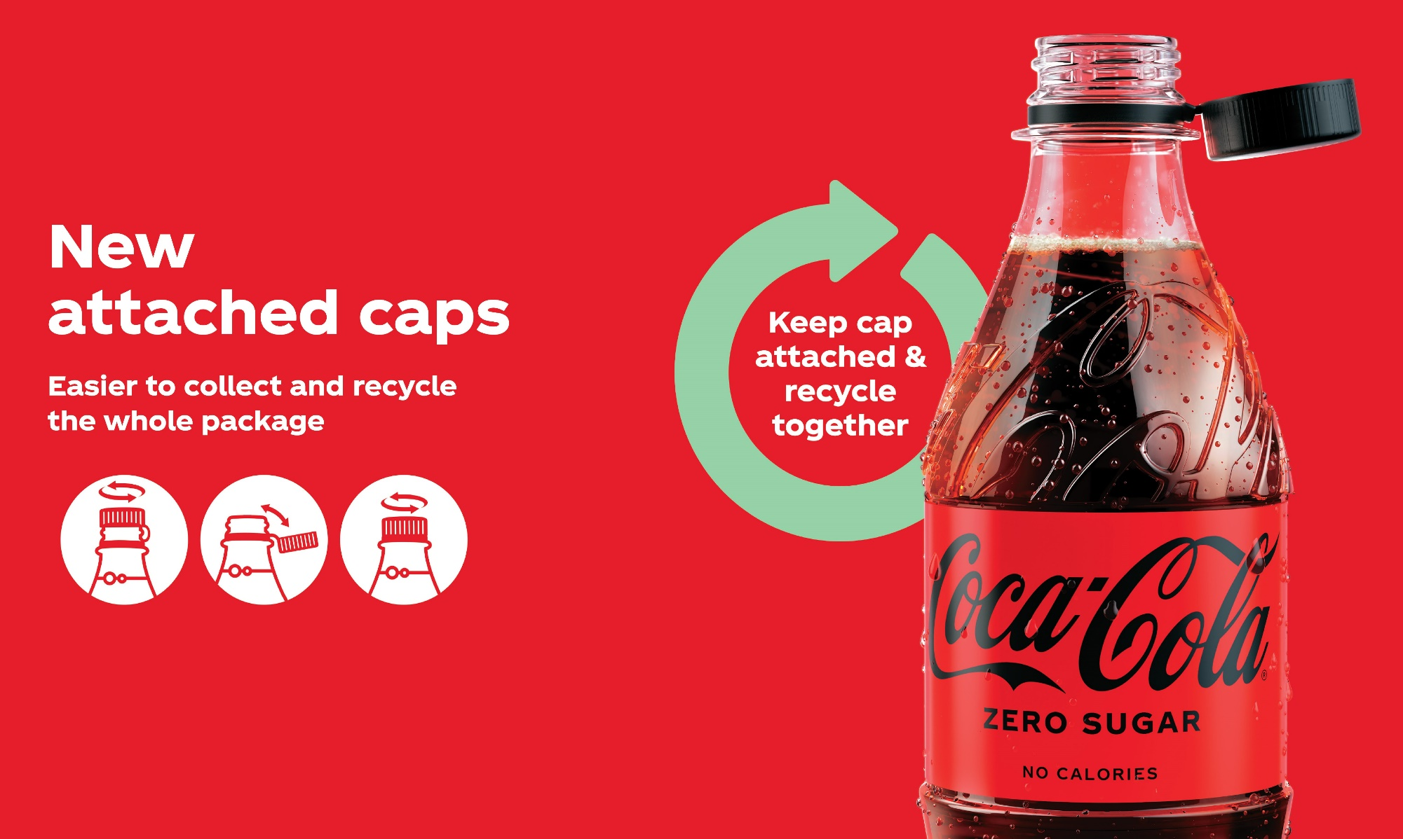
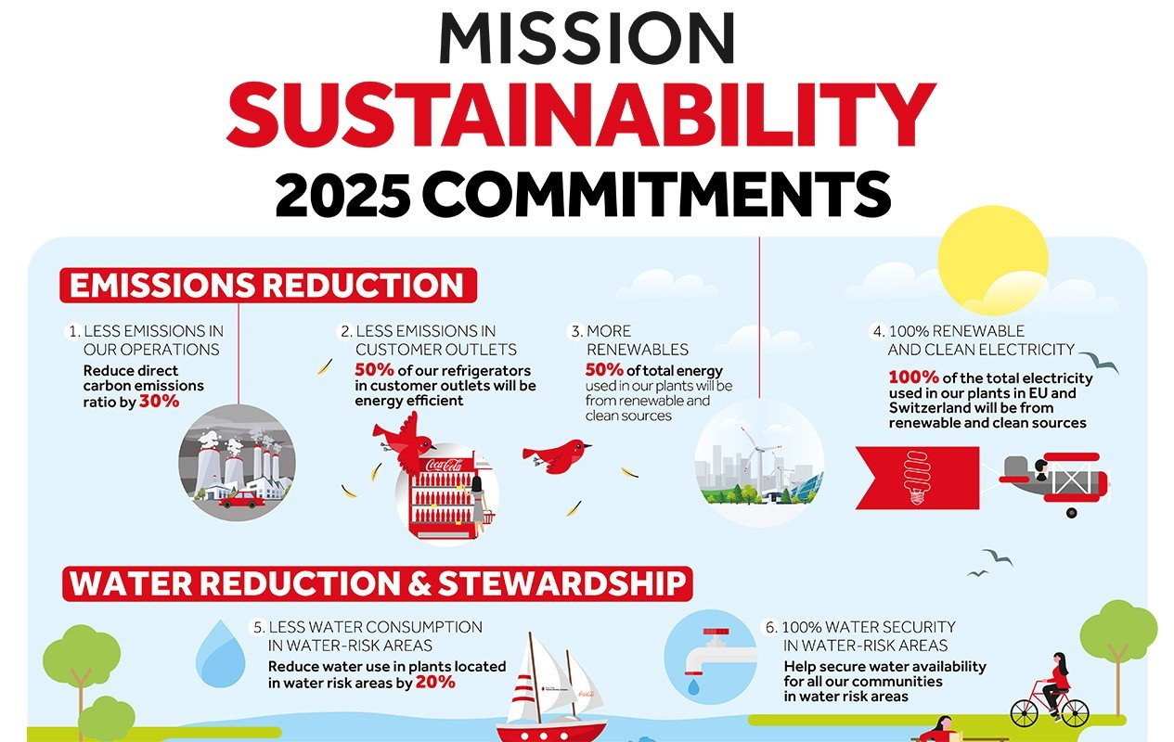
Sustainability
Reducing Carbon Emission By 25%
100% Plant Based Bottles
Bottles with Attached Bottle Caps
Vending Machines With Climate Friendly Coolers to reduce CO2 Emission
Reducing Virgin Oil Based Plastic From Bottles

Slide 7
Year | Debt/Equity Ratio
2000 | 0.75
2005 | 0.80
2010 | 0.88
2015 | 1.10
2020 | 1.89
2021 | 1.53

Slide 9
2022
Total Revenue 2022
$42.34 Billion (Increased almost 10% Revenue from 2021)
Profit
$9.92 Billion at the end of Q3
Debt/Equity Ratio
1.45 for the month ending September 2022
Share value
(At the end of 2022)
$61.61 USD in INR ₹5182
CAGR
The last 3 years CAGR is 2.26% & the last 5 years CAGR is 5.24%. Expected CAGR in 2 years is 6.4%
Market Cap
$275.08 Billion (This makes Coca-Cola the world's 32th most valuable company by market cap)

Slide 10
Marketing

Slide 11
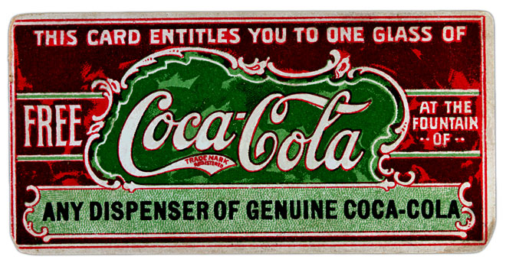
Marketing Strategies
Free coupon sampling (1894-1913).
8.5 millions coupons redeemed.
1/9 people acquainted with coca cola in USA.
Identified as national brand in beverage industry.

Slide 12
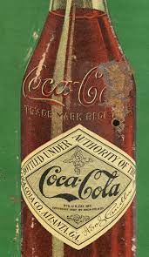
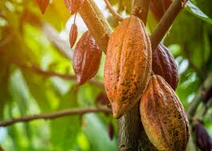
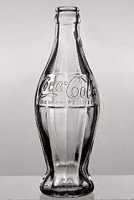
Unique Bottle Designing (1915)
In 1915, the Coca-Cola Co. introduced a diamond-shaped label with a colorful trademark, but the labels would peel off when stored in ice-cold water.
Competitors start coping the coca cola bottle design.
Designed a “bottle so distinct that one could recognize it by feel in the dark or lying broken on the ground".
Cocoa Pod

Slide 13
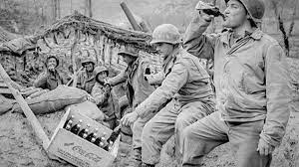
World War – II (1939-1945)
Every man in uniform gets a bottle of Coca-Cola for five cents, wherever he is and whatever it costs the company.
U.S. Army General request included 10 portable factories, 6 Million bottles monthly to quench the thrust of U.S. Soldiers.
5 Billion bottles were distributed to those in uniform during the world war - II.
Expanded from 10 portable factories to 64 factories by end of war 1945.
Transformed war time factories to fully functional factories.
Coca-Cola ran a series of ads which expressed Coca-Cola as a patriotic brand.

Slide 14
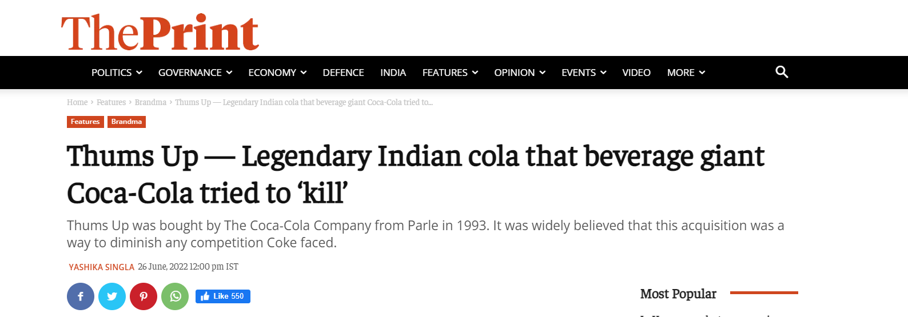
Acquiring or Merging Strategy
Coca-Cola acquire or merge with well doing companies to in return increase its profit and business in global market.
Lucrative offers to competitors bottling partners .
Thums up, Gold spot, Citra, Maaza was bought by The Coca Cola Company from Parle in 1993 ($40 Million).
Gold spot relaunched as Fanta and Citra relaunched as Sprite.

Slide 15
Rural Marketing Strategy
3 Major Problems of Coca Cola
Road and Transportation Issue
Availability
Economically Poor
Affordability
Rural Consumer behaviour
Acceptability

Slide 16
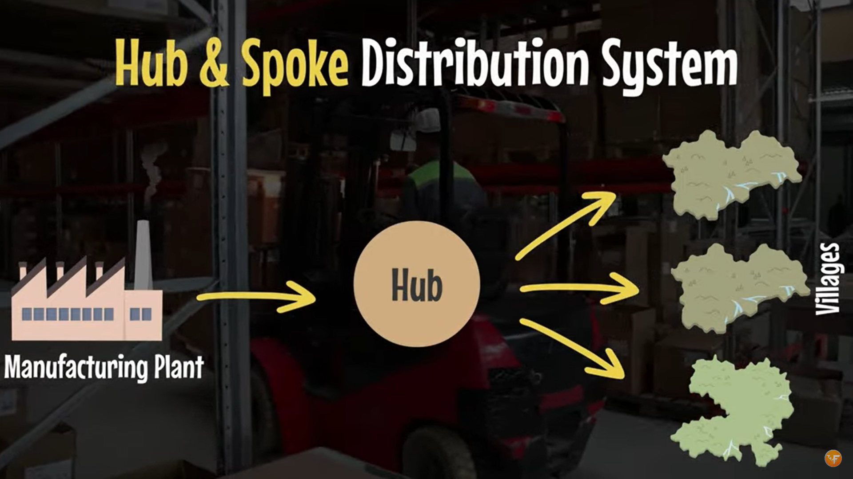
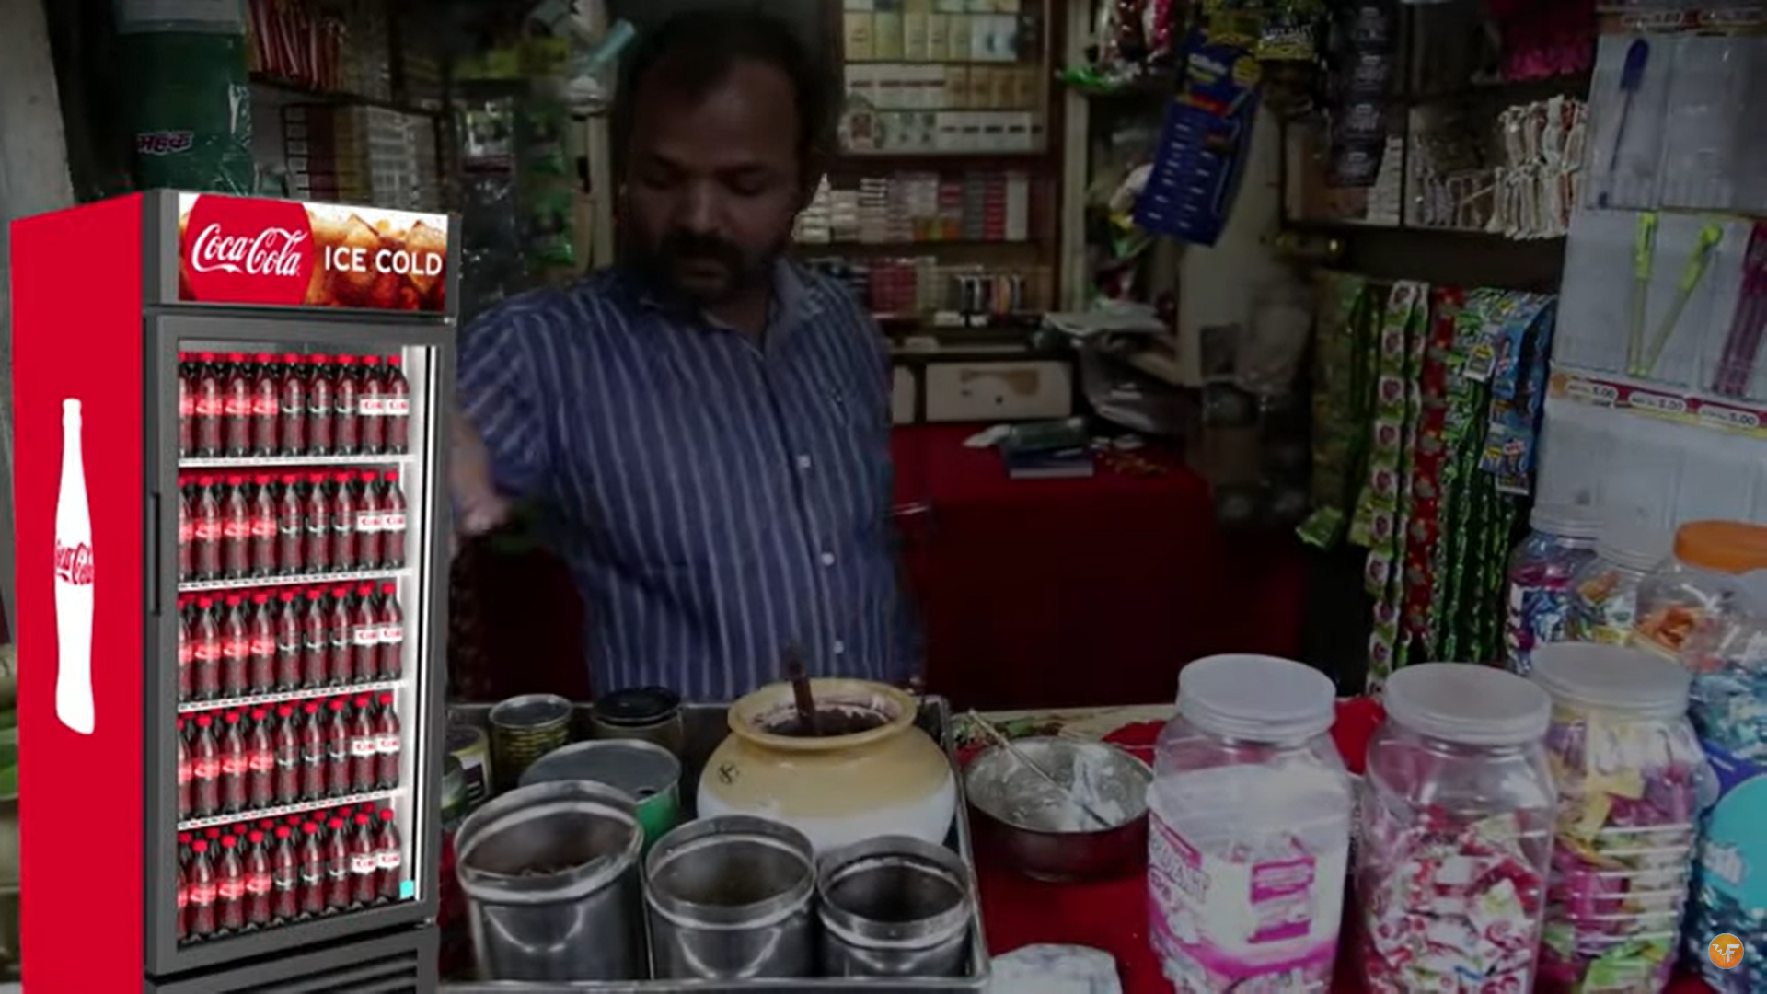
Road and Transportation Issue
Availability
Hub & Spoke Distribution
Distributed Refrigerator to Retailers

Slide 17
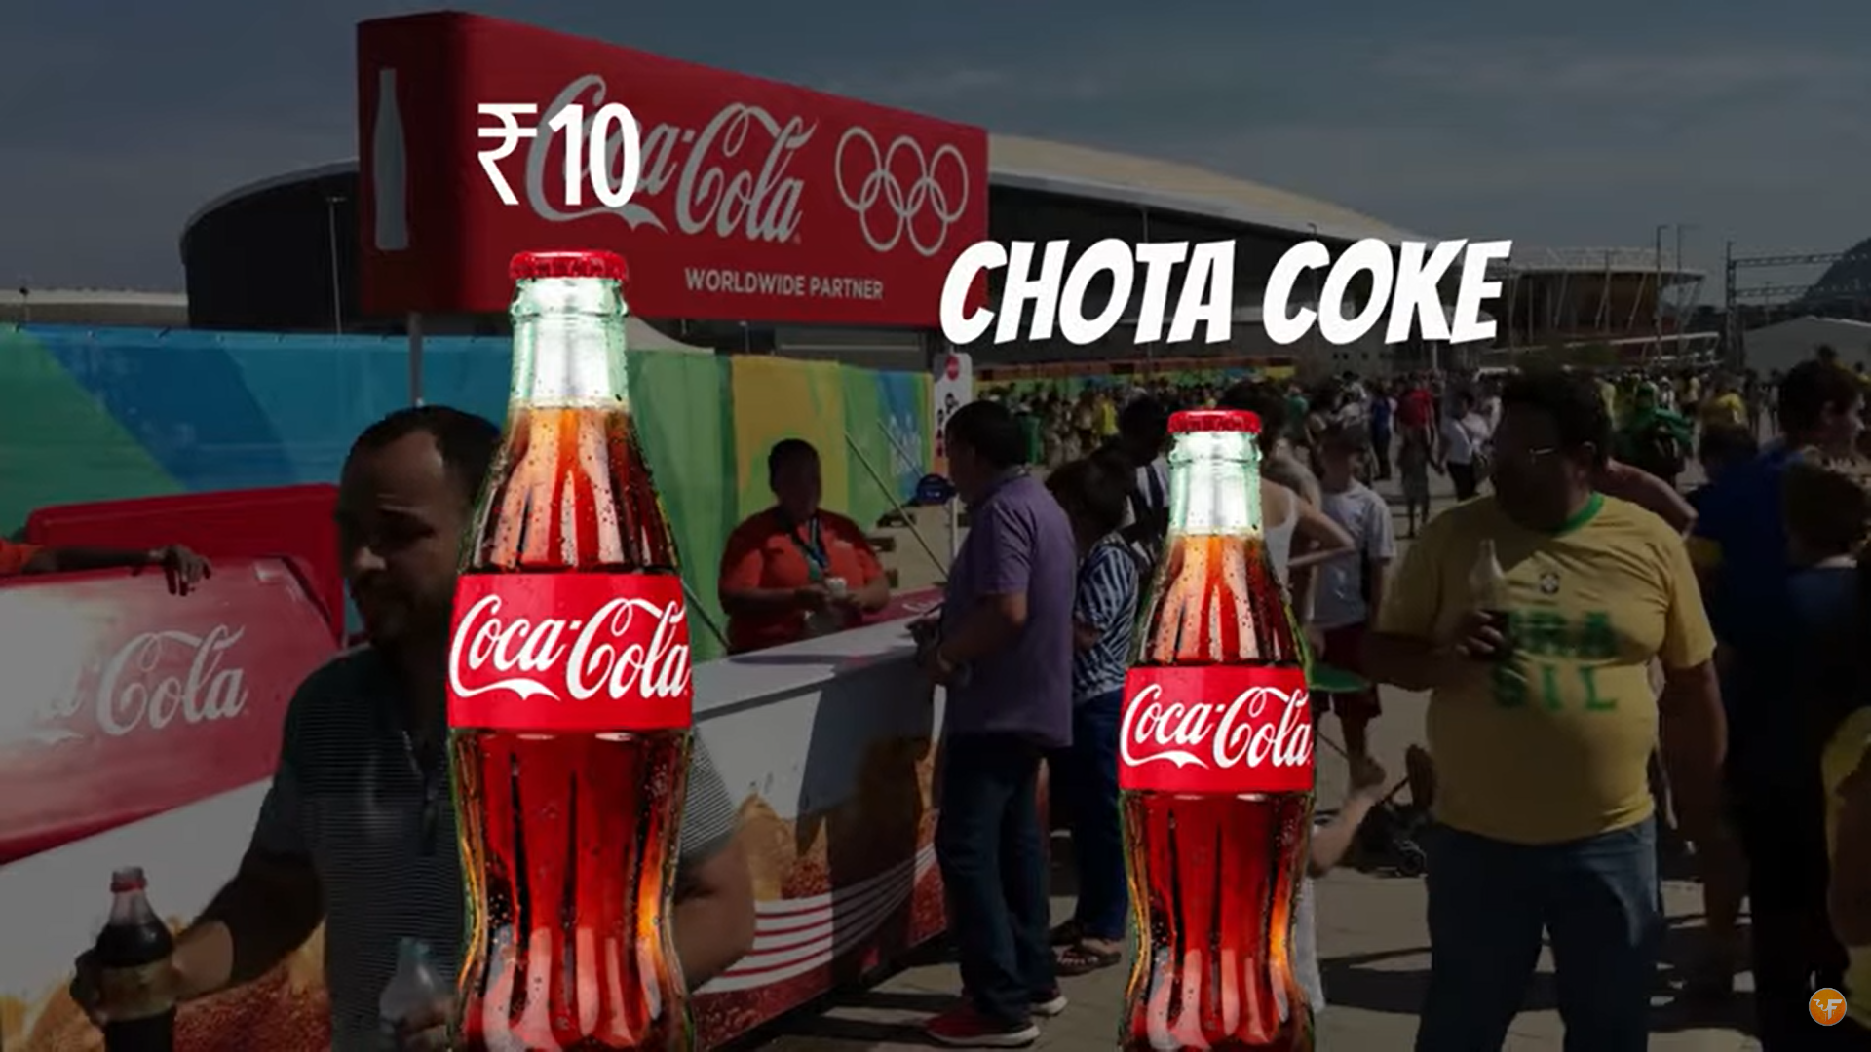
Economically Poor
Affordability
Rural Market is very price sensitive.
India launched “Chota Coke” of 200 ML just for 5 Rupees.

Slide 18
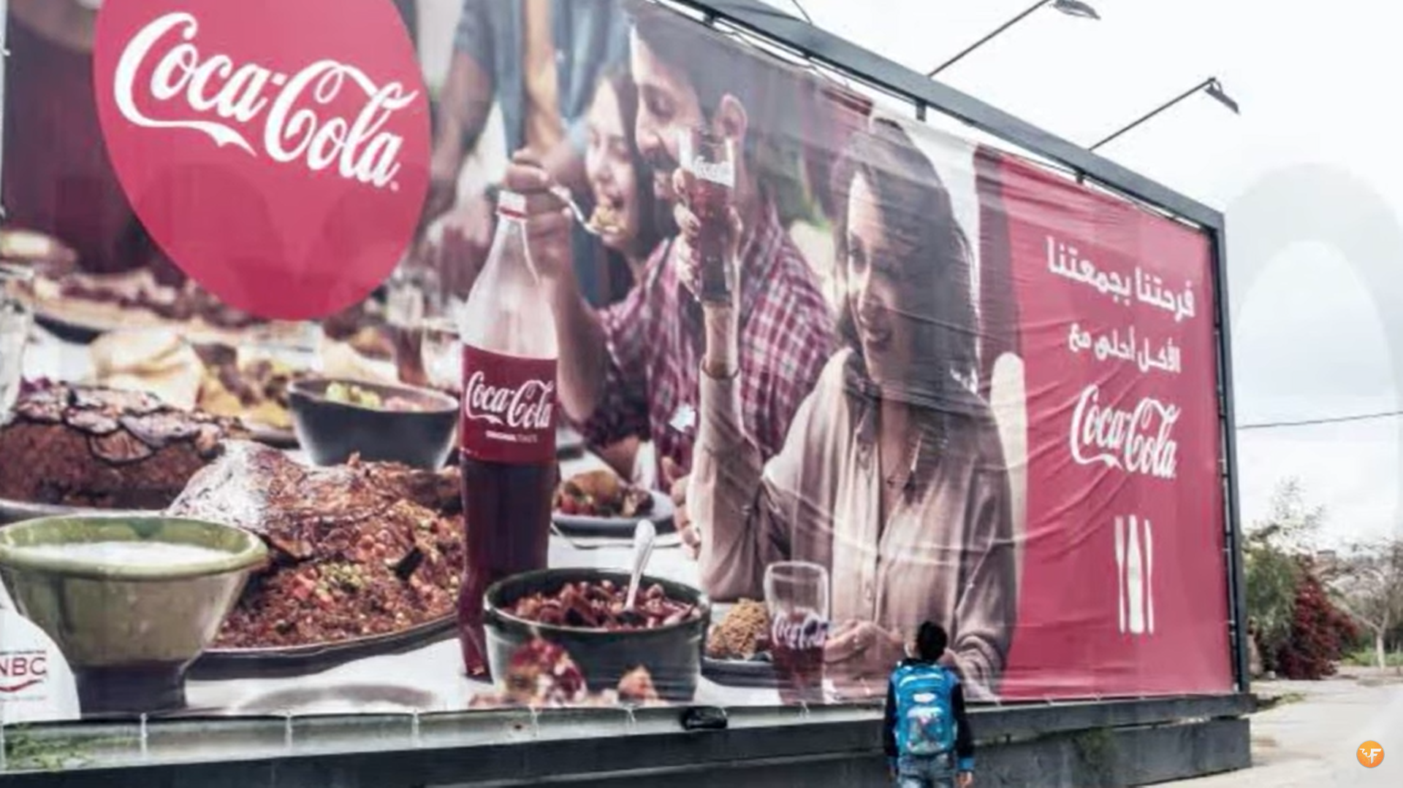
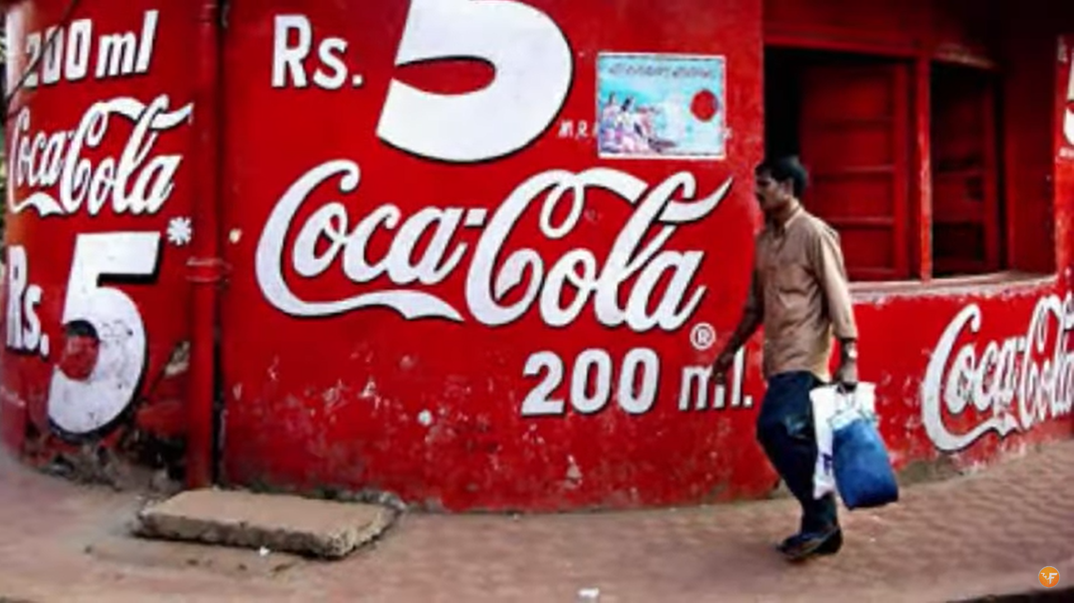
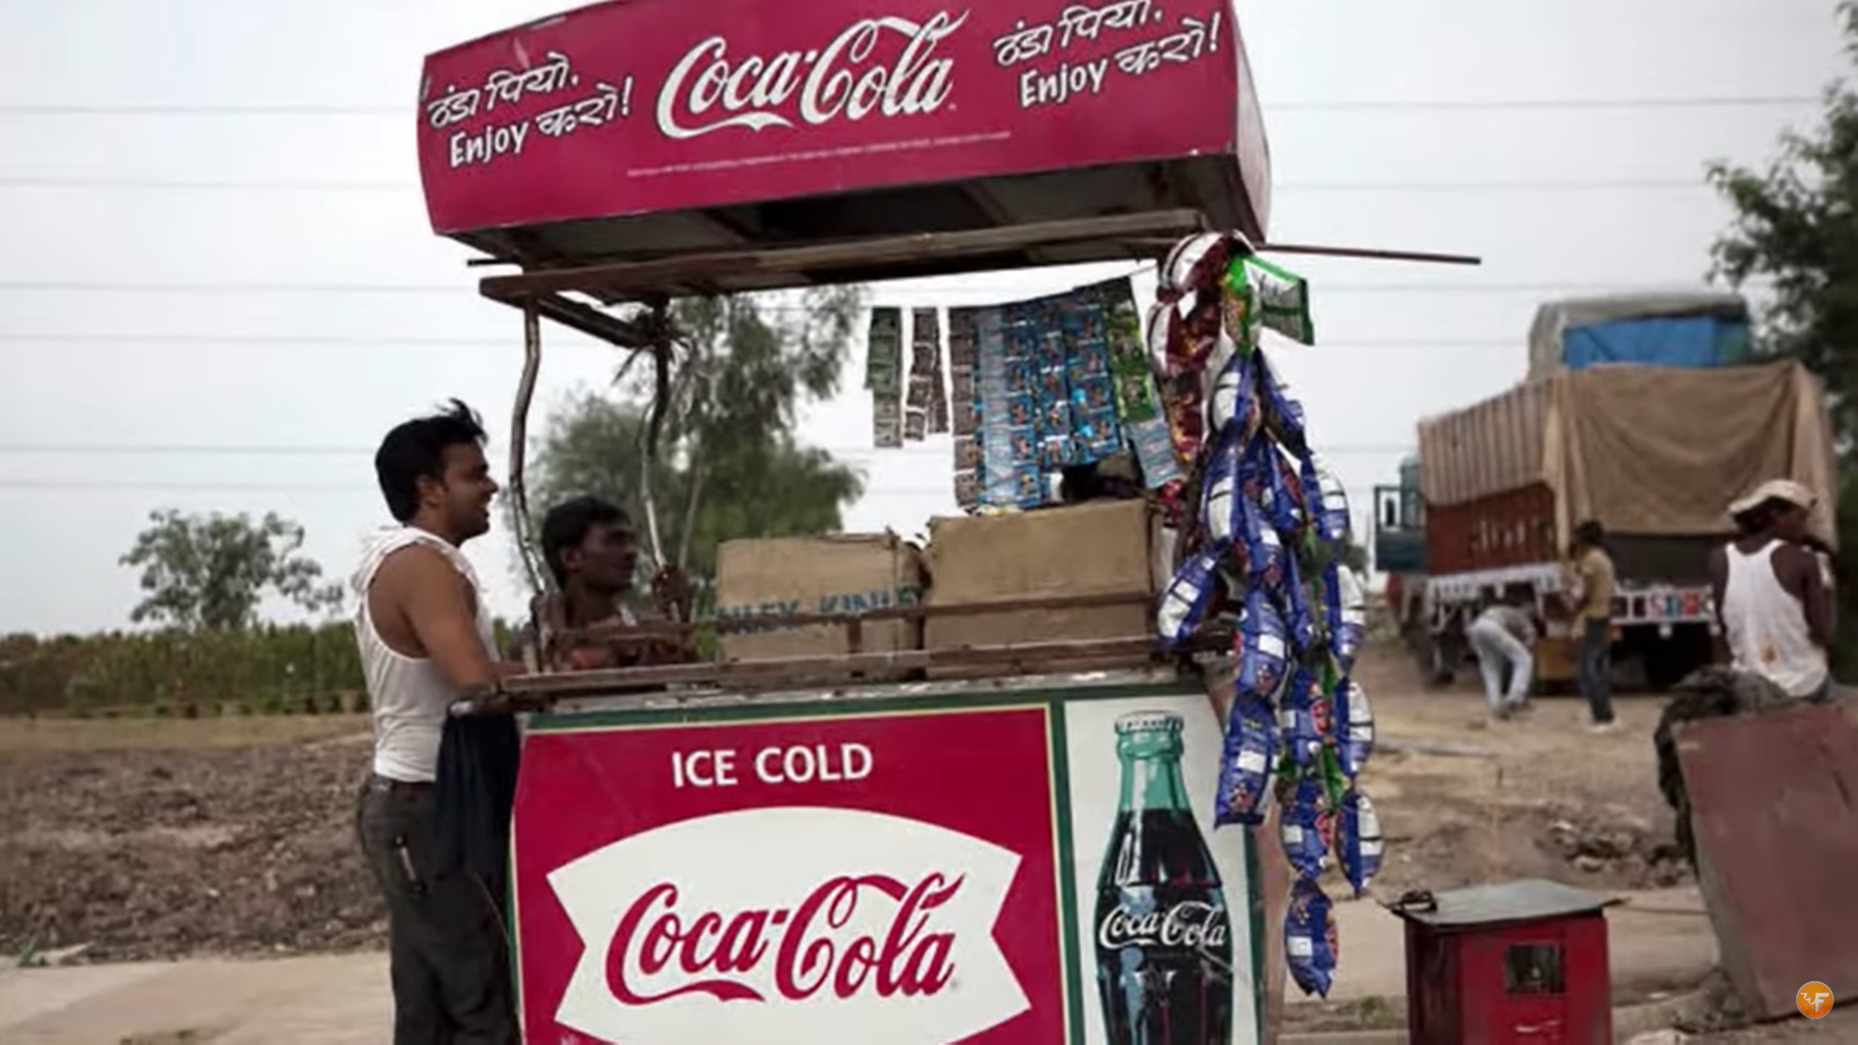
Rural Consumer behaviour
Acceptability
Acceptability requires heavy marketing and branding, They heavily focused on offline channels and online channels for the marketing,
Offline Channels
Put up Huge Holdings
Painted the Walls
Heat/Mandi(Weekly Bazaar)
Online Channels
Commercial ads with Bollywood celebrities in the village attire (Amir Khan).
Commercial ads with Famous Sports Player (Sachine Tendulkar).
Prime moto of online channels was Making coke a generic name for the Thunder(Thanda).

Slide 19


Slide 20
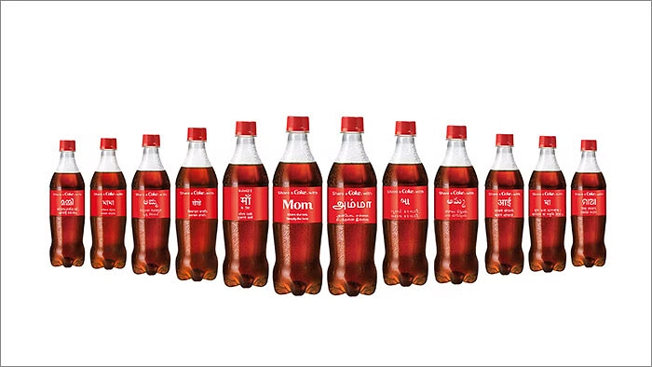
Sharing a coke campaign
Share a Coke is a multi-national marketing campaign of coca cola
Aims to have people go out and find a bottle with their name on it, then share it with their friends
In India they printed such names in 26 different languages

Slide 21







ROADMAP
WORLD WITHOUT WASTE
Make 100% of packaging recycled by 2025
2030
LOW/NO SUGAR PRODUCTS
2025
19 Of Top 20 brands Have reduced sugar percentage
2022
TOTAL BEVERAGE PORTFOLIO
fulfill consumer's beverage needs preferences all day

Slide 22
Giving people options and choices From sparkling water to dairy, to refreshing soft drinks and natural juice, we offer over 200 brands worldwide, including reduced-sugar drinks and smaller packages.
Giving people options and choices
Maximizing water conservation

Slide 23
World Without Waste
Target to reduce carbon emissions 25% by 2030
Coca-Cola aims to collect and recycle a bottle or can for every one we sell and make 100% of our packaging recyclable.

Slide 24
That’s how Cola cola spends around 4.5 billion dollars only in its marketing strategies and makes billion of dollars profit

